Slide 1
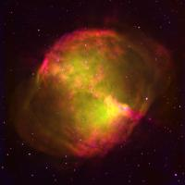
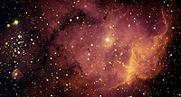
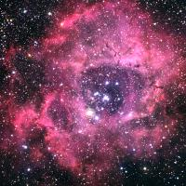
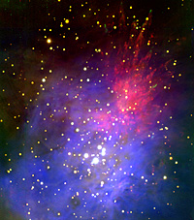
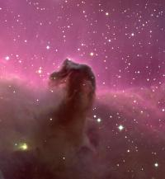
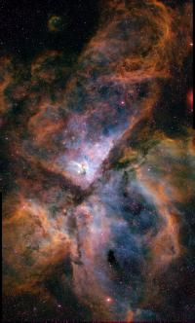
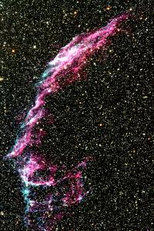
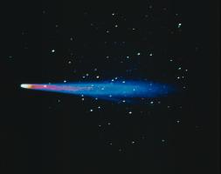
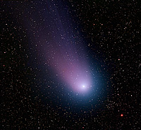
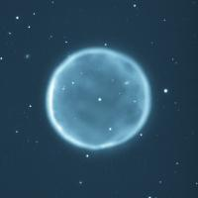
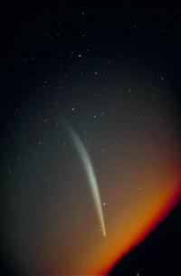
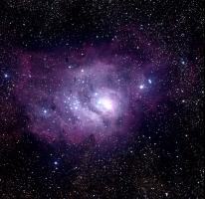
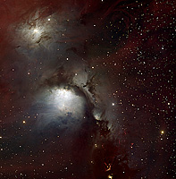

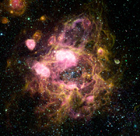
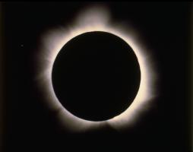
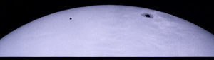
Applying Your PhD to a Future Career in Data Science
Christopher J. Miller
University of Michigan
Notes:
Maybe? People like astronomy pictures

Slide 2
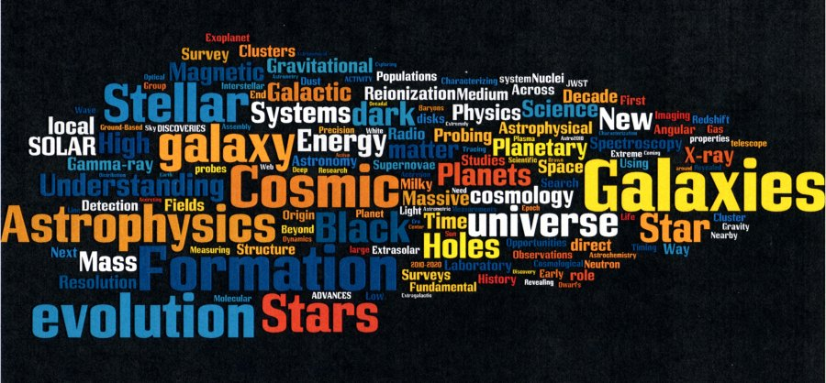
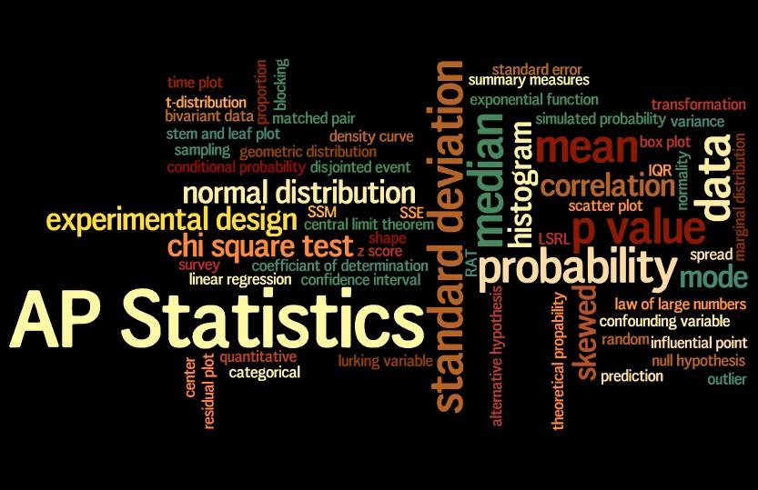
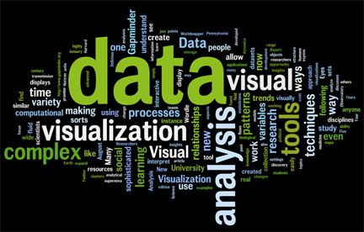
Notes:
Explain the concept of Astroinformatics

Slide 3
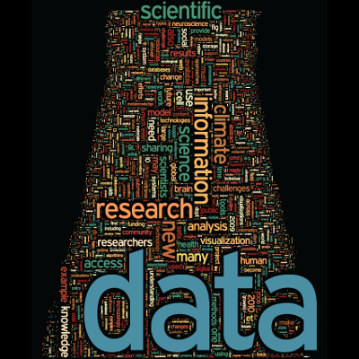
Big Data and Astronomy
Astronomy provides a sandbox
Data is voluminous, complex, heterogeneous
Open source software and data access
Resources are key to future success
Computing brain power
Outside domain expertise
Storage, network, computation, visualization connectedness
Professional advancement is following a new model for PhD Scientists
New data science centers will provide real world experience for academically trained PhDs

Slide 4
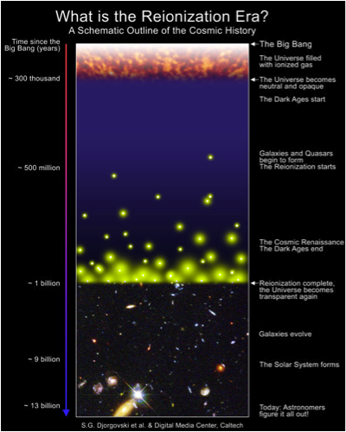
Astronomy is remote sensing
We cannot repeat (or change)
the Universe in a controlled
environment. We cannot make
planets, stars, or galaxies. We
cannot make the vacuum of
space, nor the shape of space-
time around a black-hole.

Slide 5
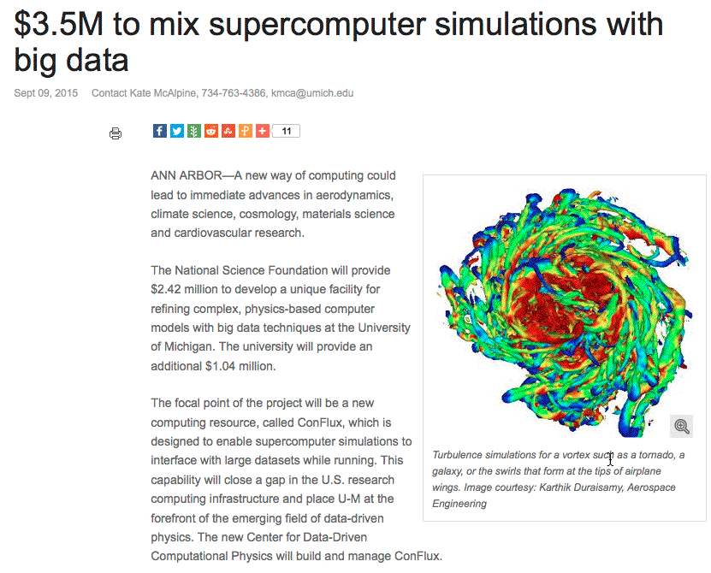
Connecting Big Data and Theory

Slide 6
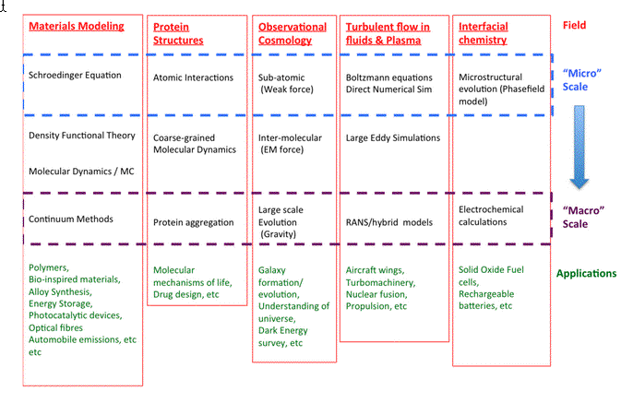
Other Domains
UM internal document

Slide 7
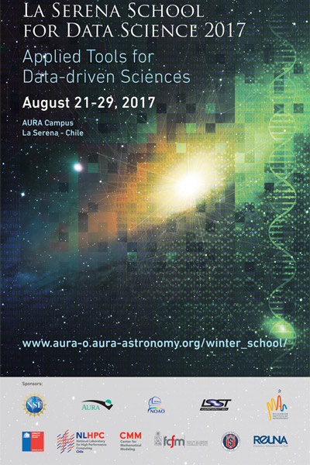
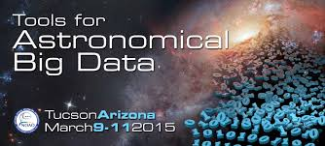
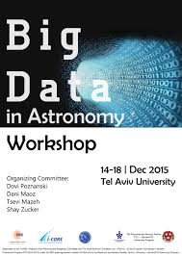
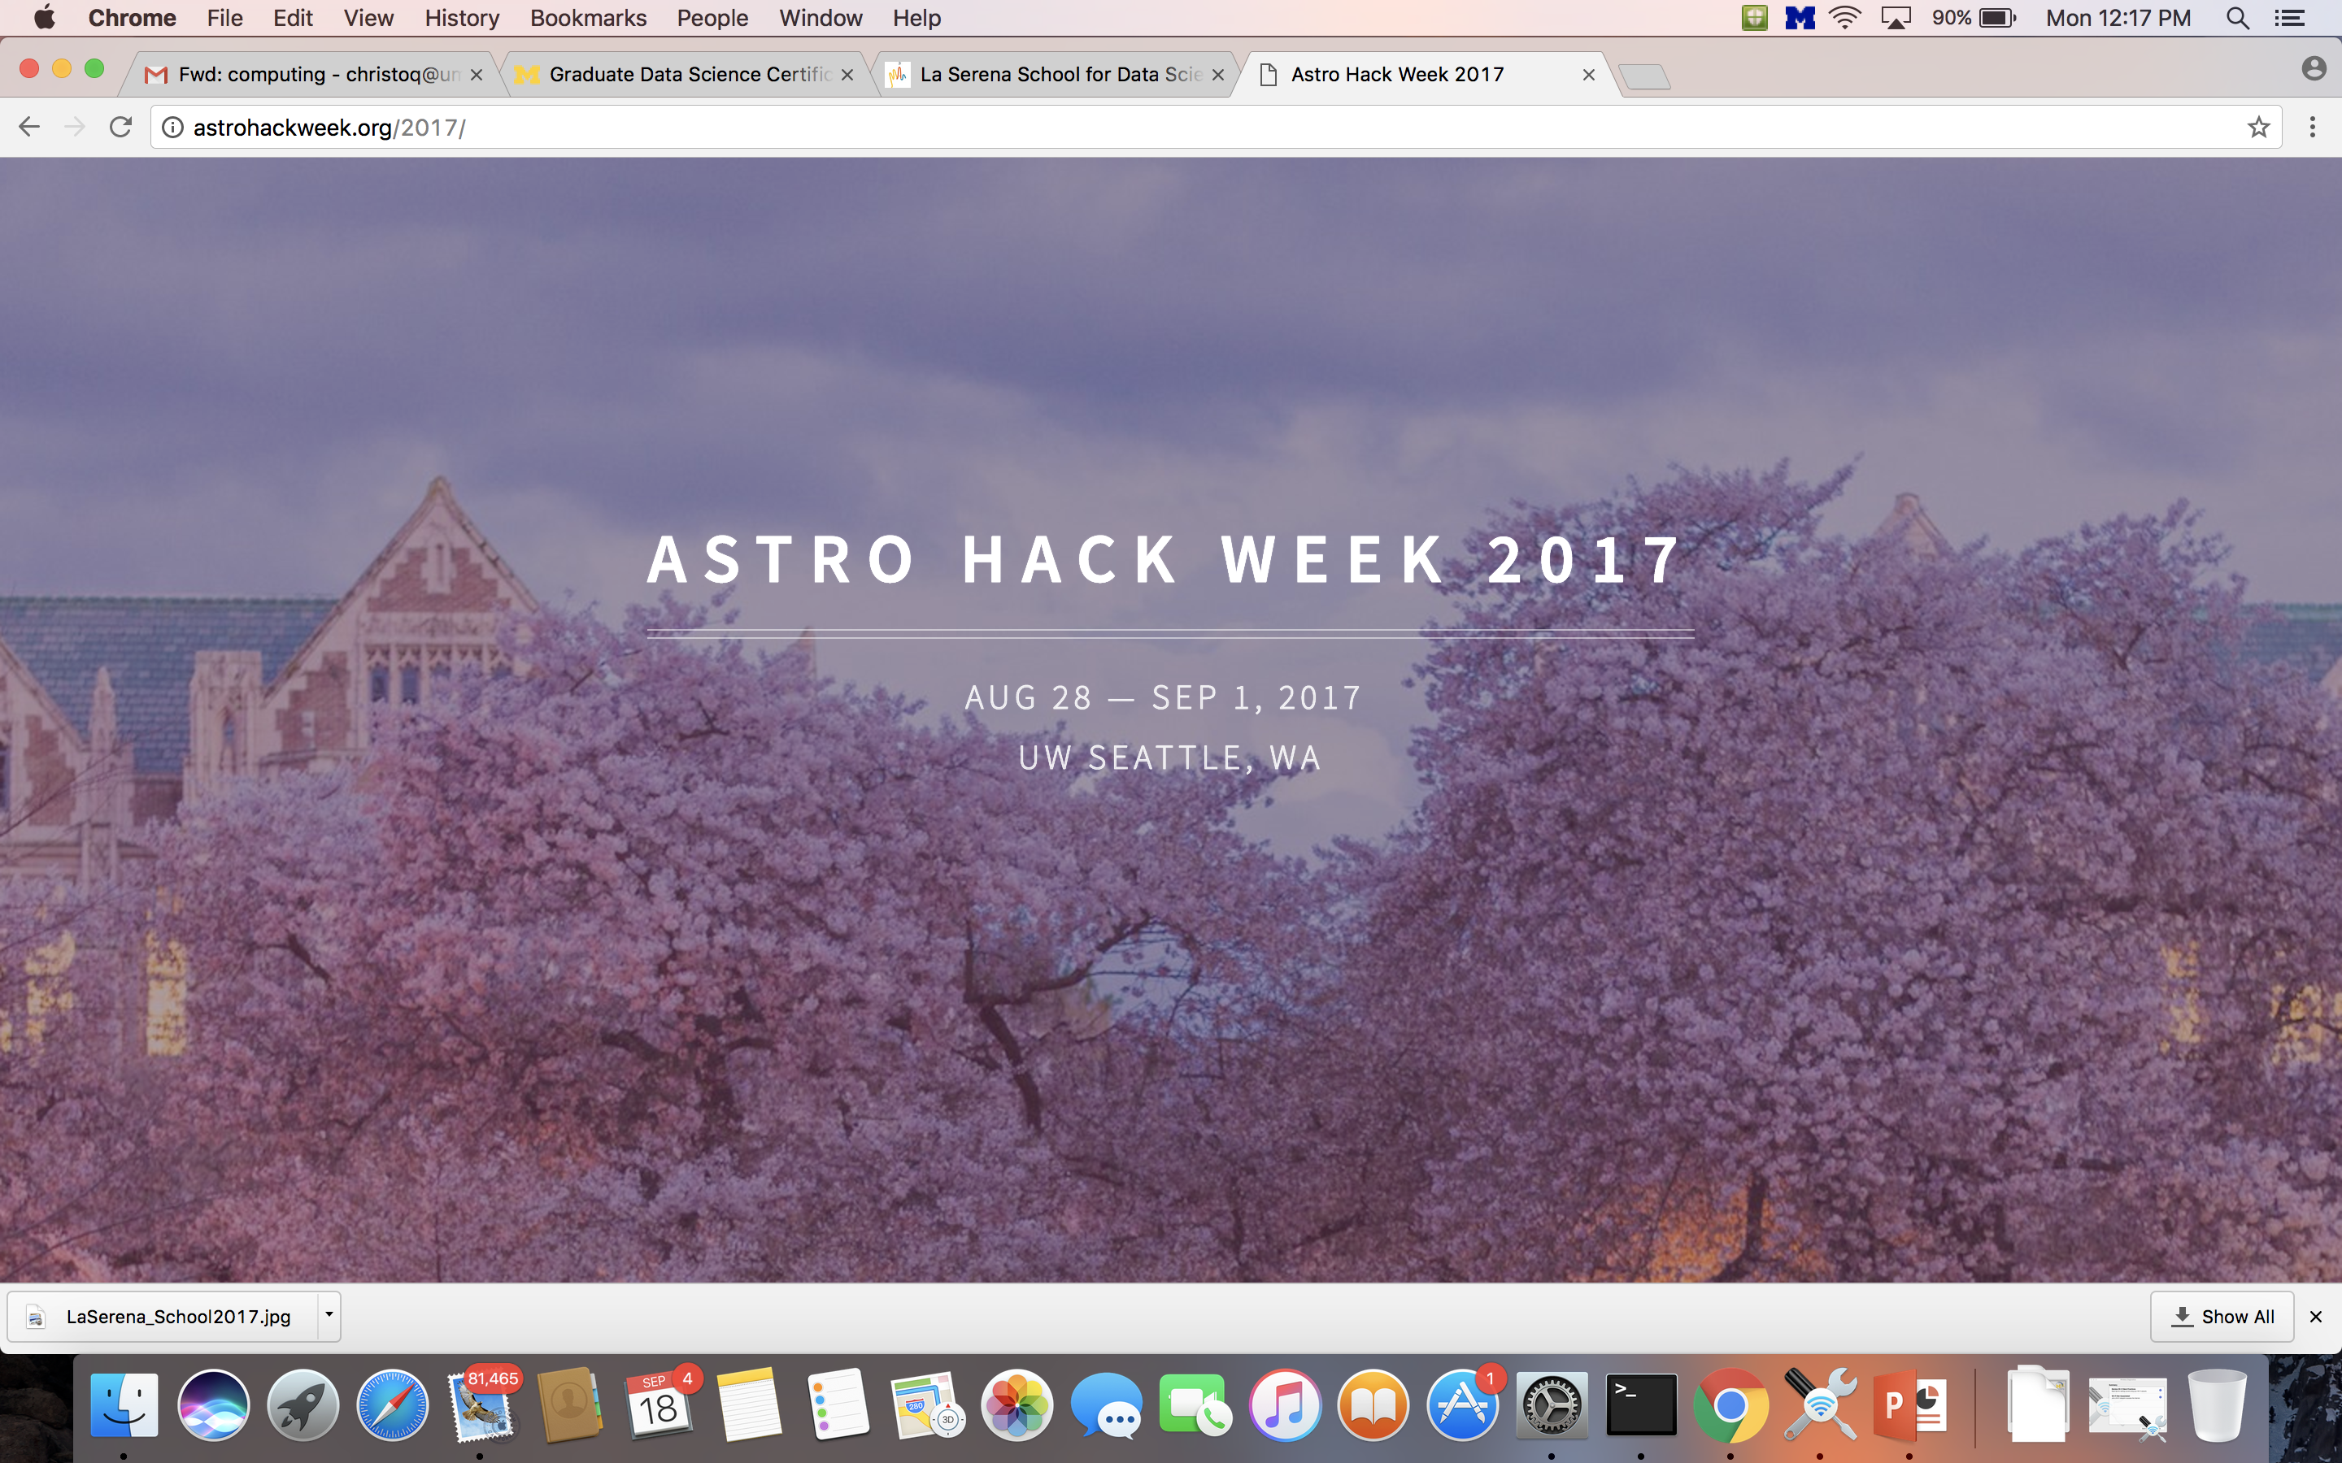
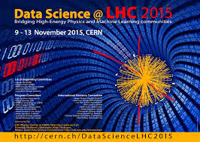


Data Science Training

Slide 8
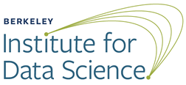
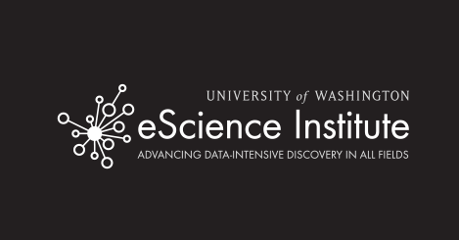

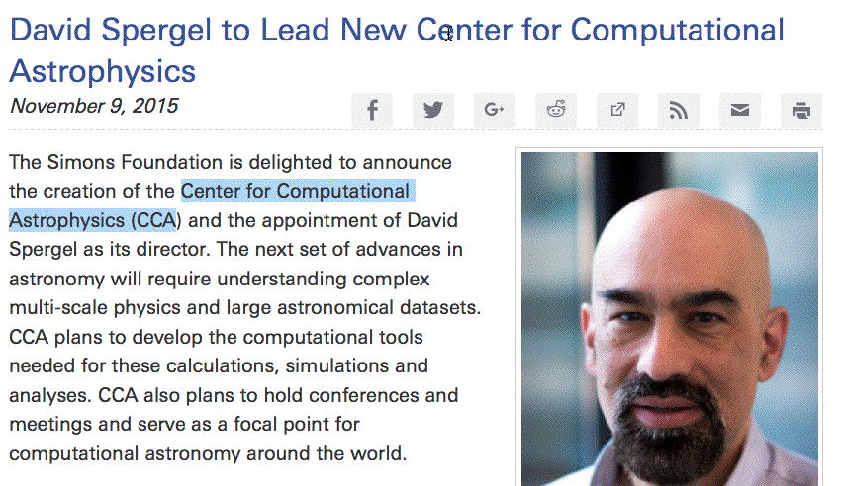
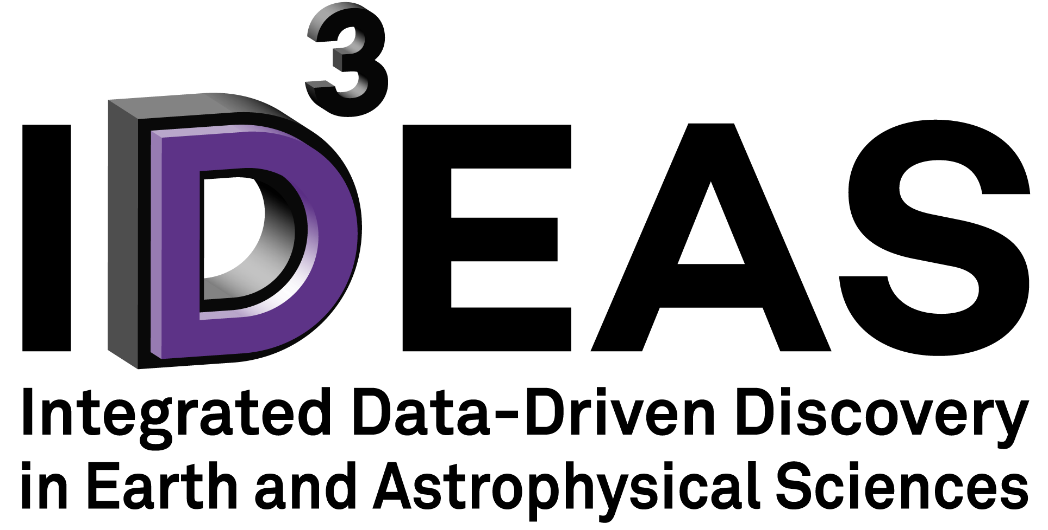


The Emergence of Data Science Institutes
Vicky Kalogera

Slide 9
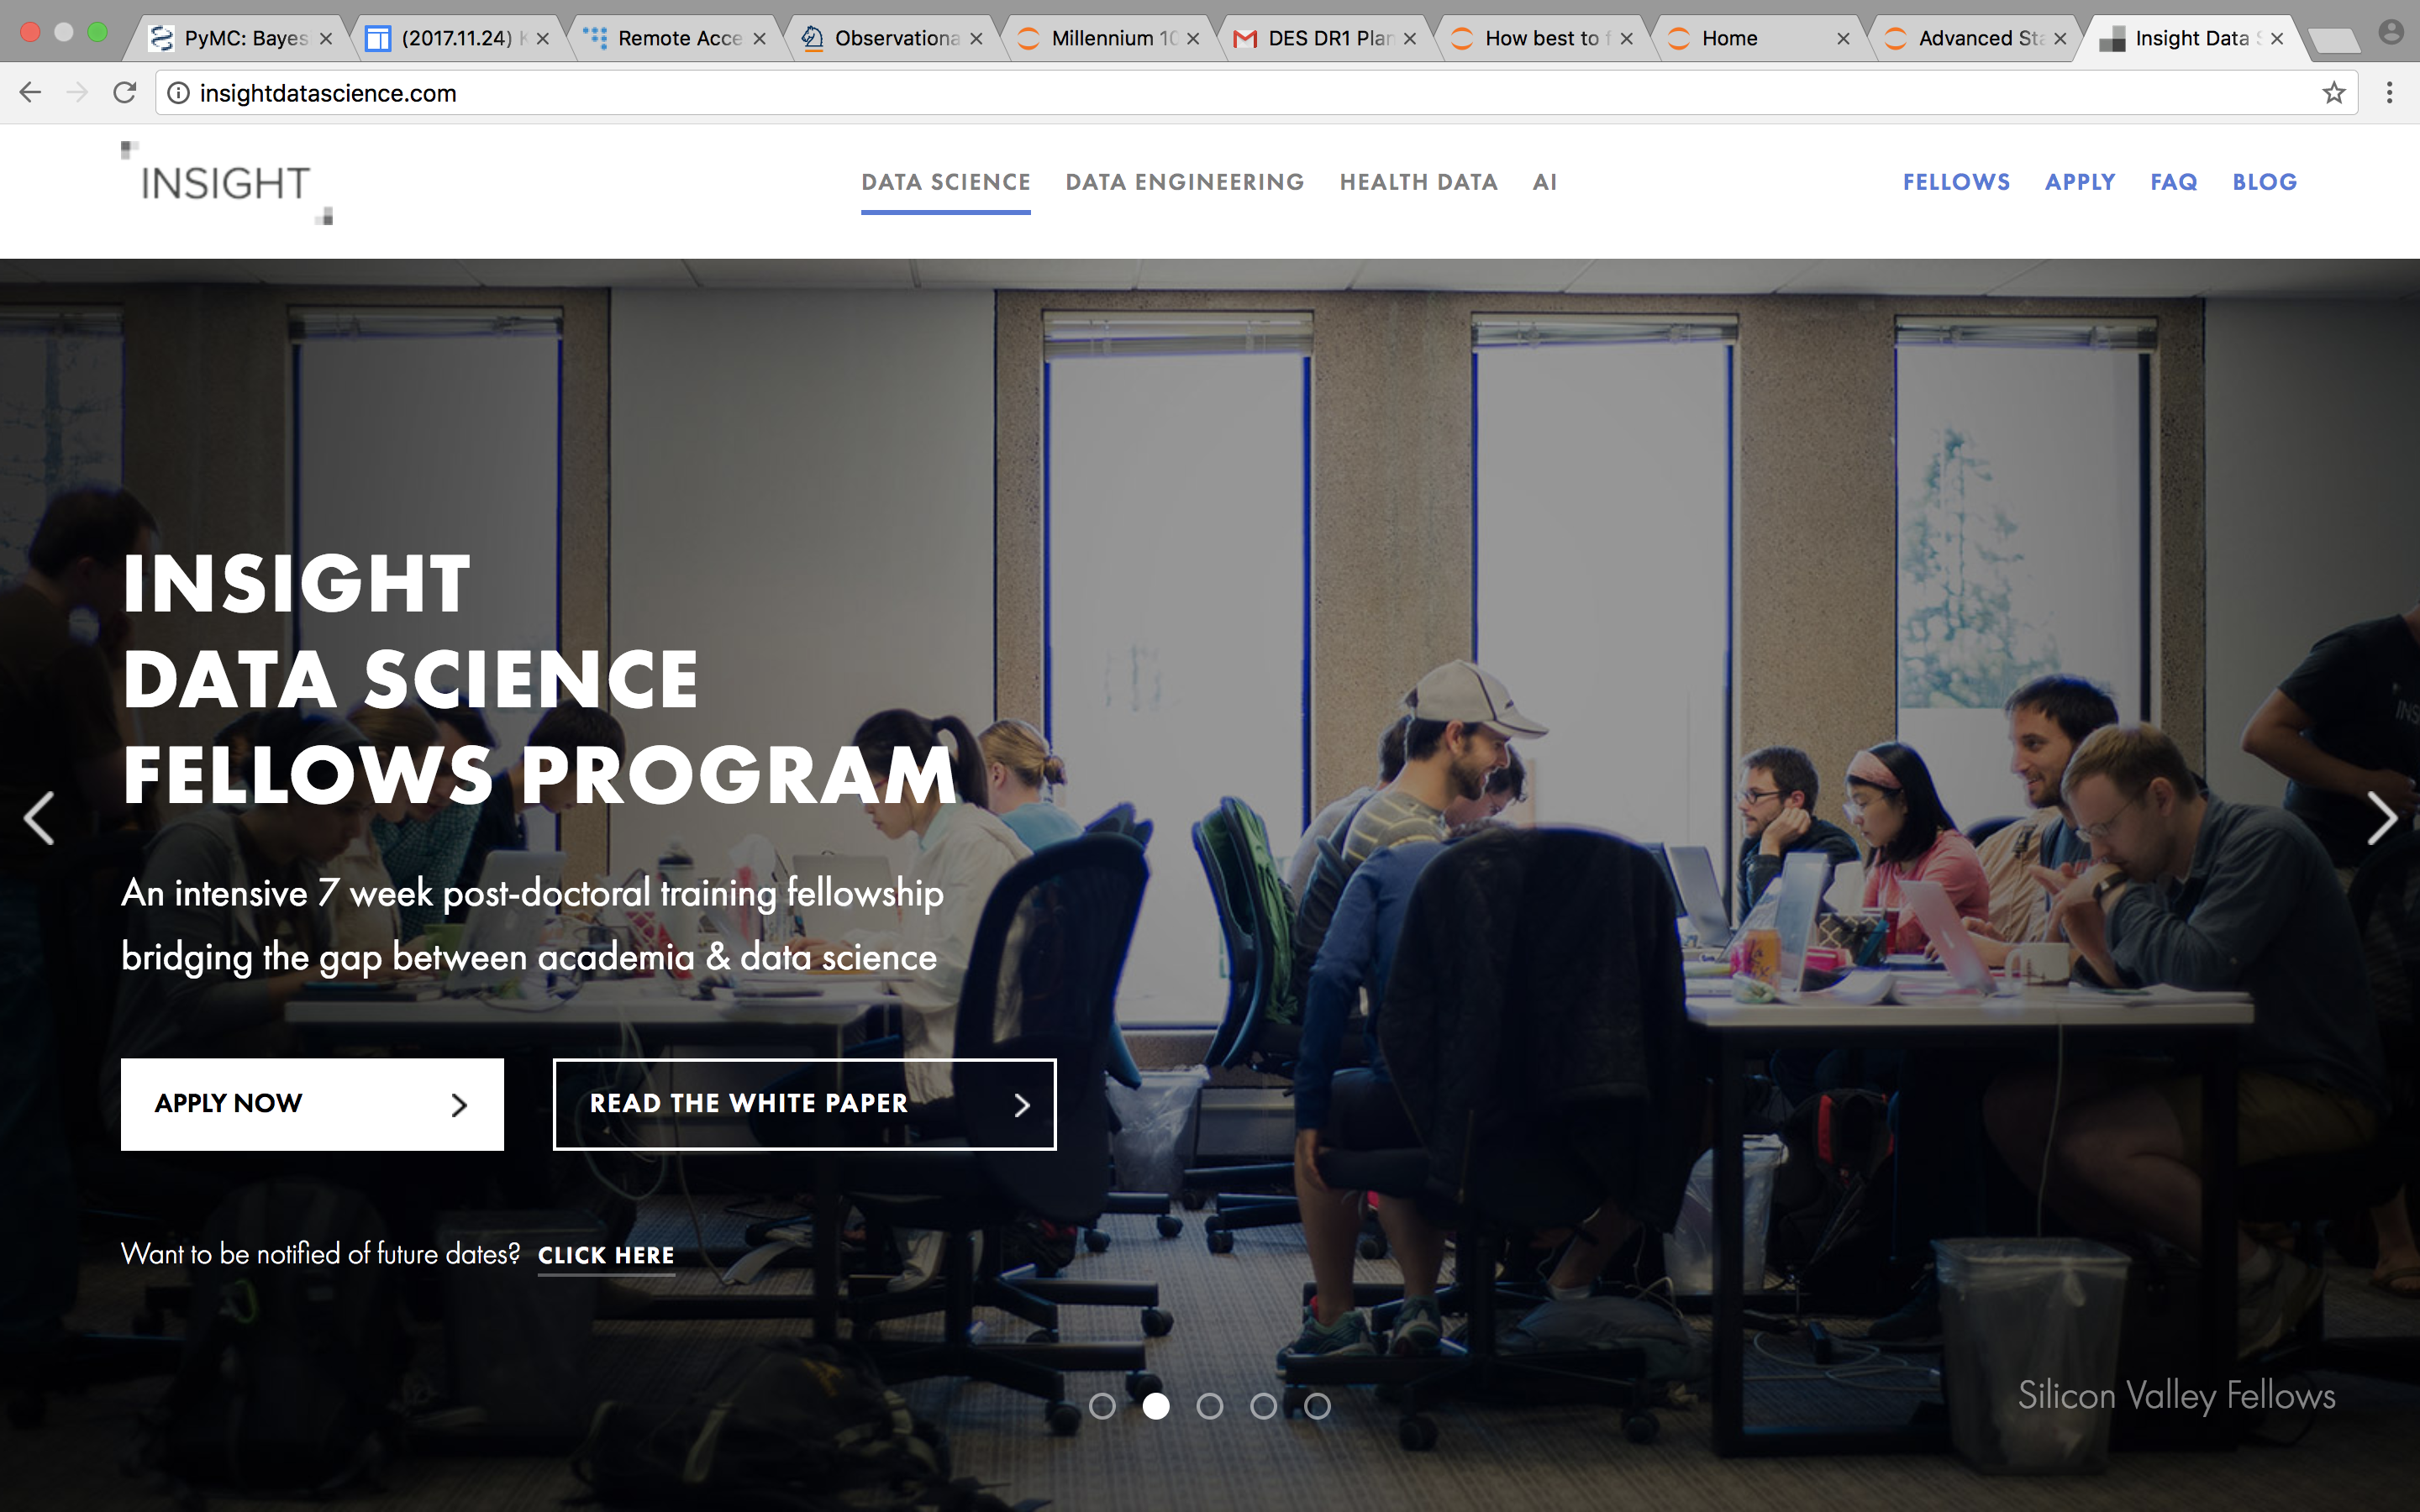

Slide 10
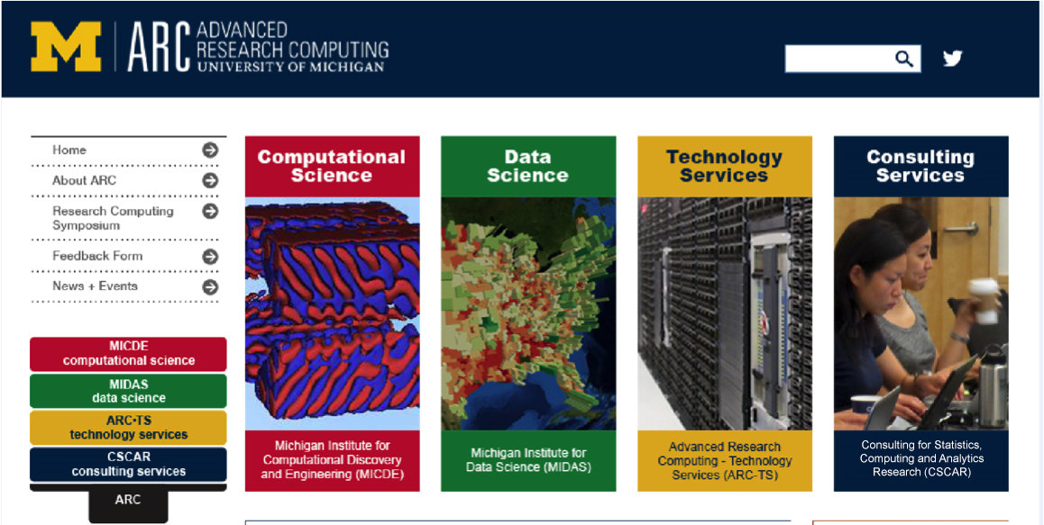
Michigan’s Data Science Initiative

Slide 11
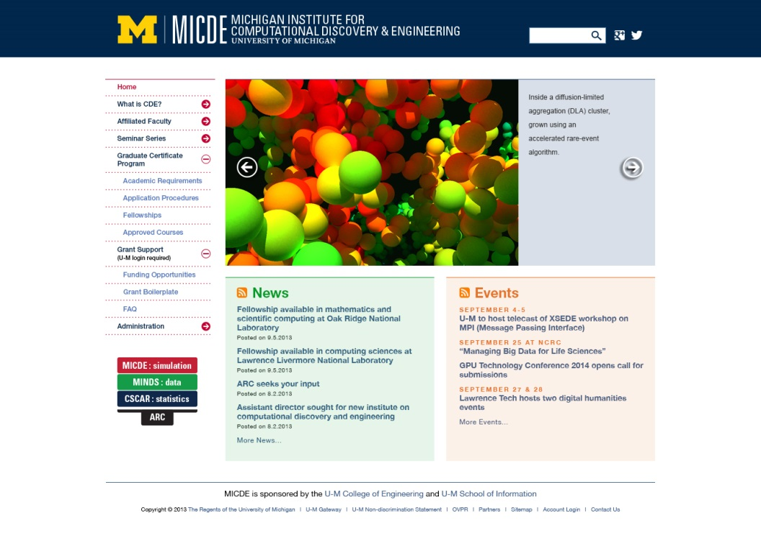
Computational Science

Slide 12
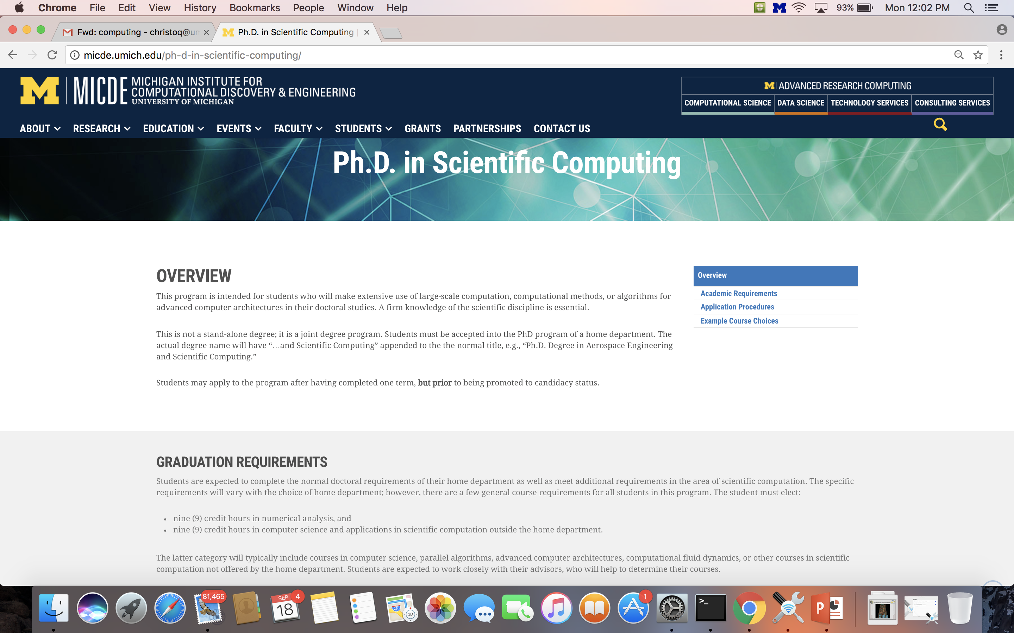
Computational Science

Slide 13
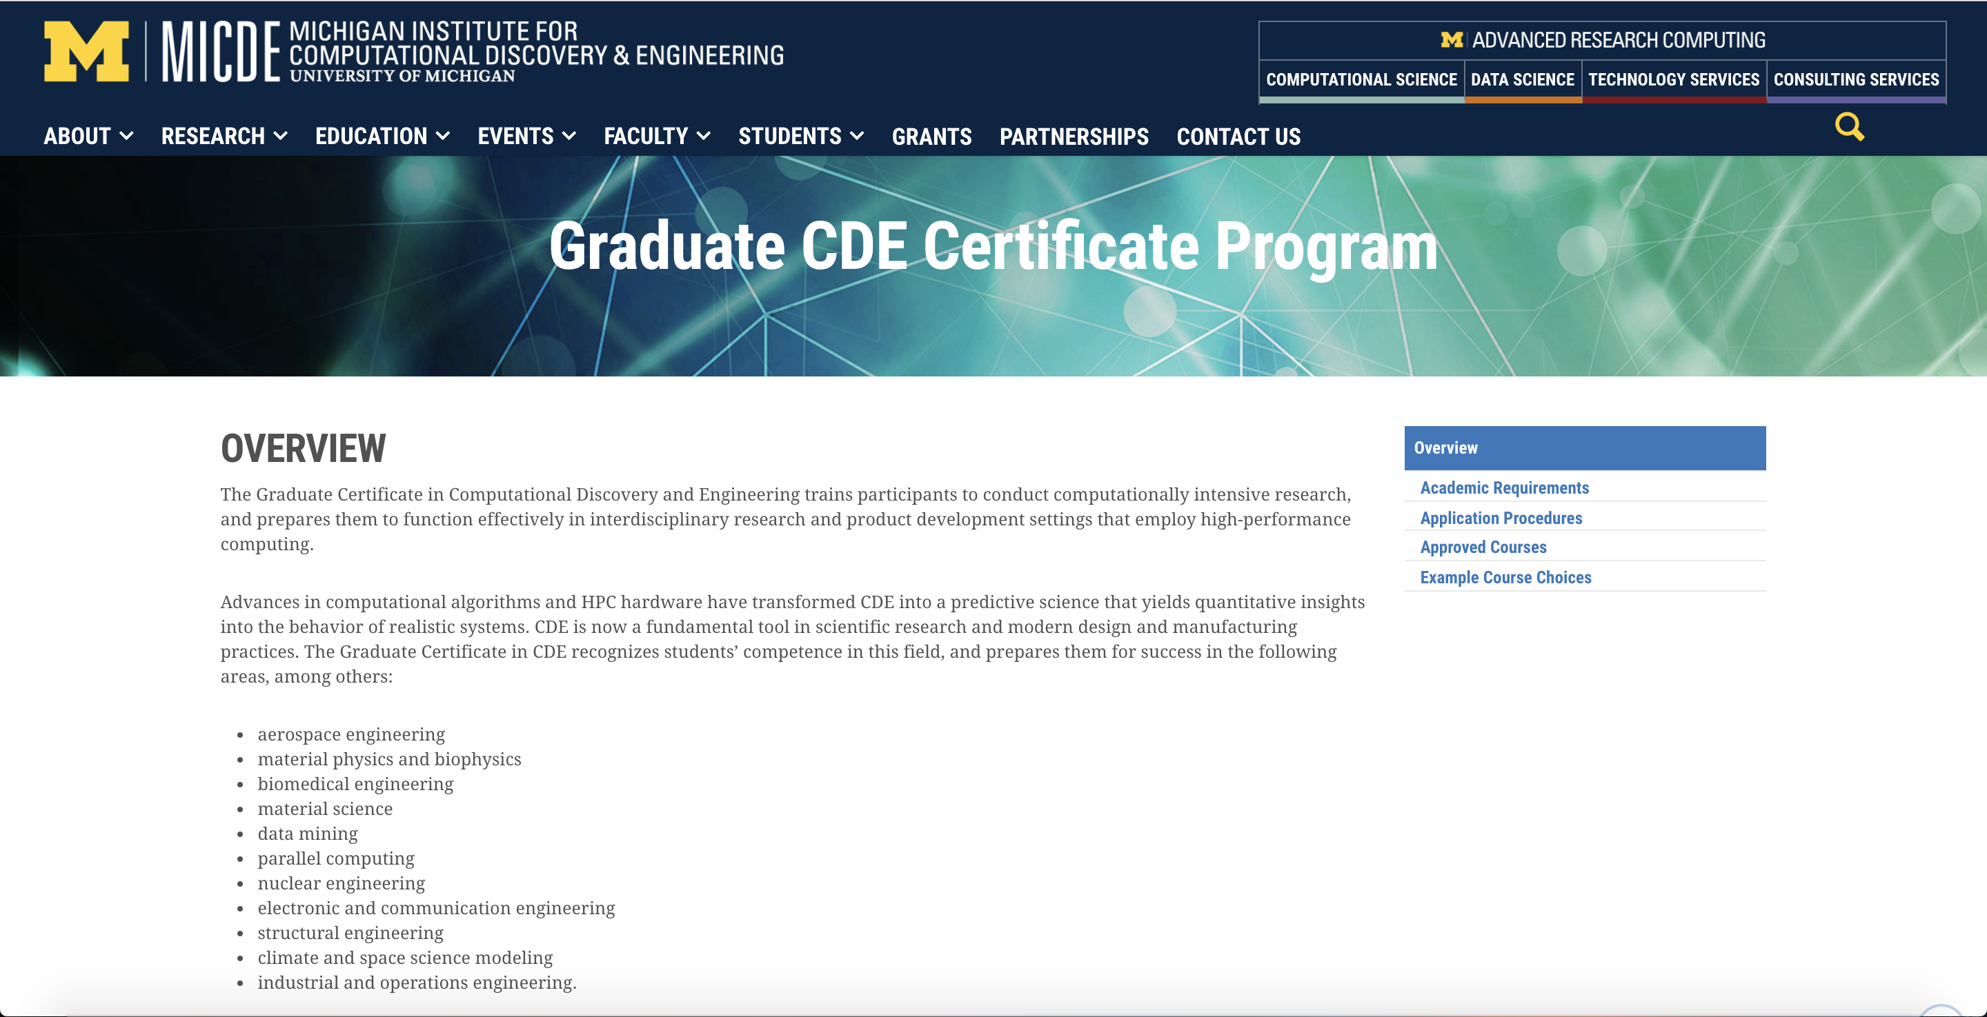
Computational Science

Slide 14
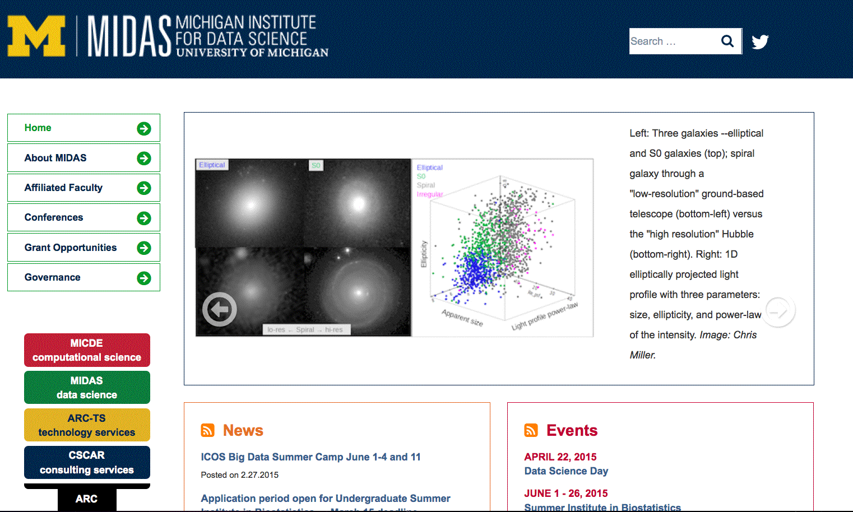
Data Science
Connecting people and ideas across disciplines.

Slide 15
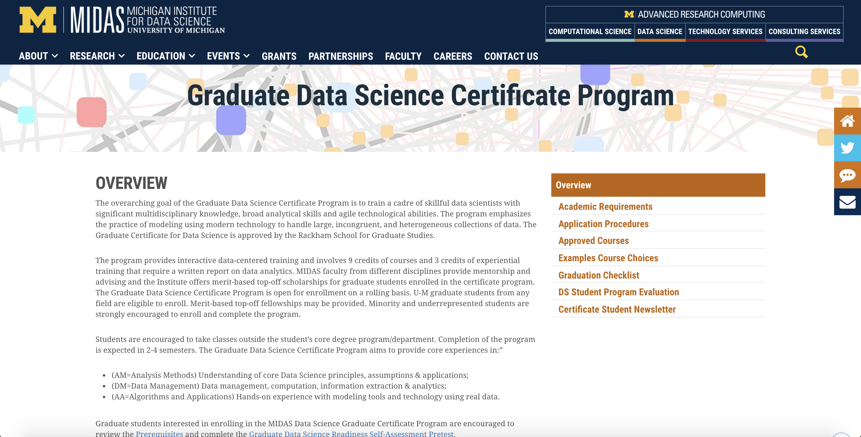
Data Science

Slide 16
Data Science
Connecting people and ideas across disciplines.

Slide 17
Technology Services
GPUs, parallel, massively serial, high memory, HADOOP, etc.

Slide 18
Technology Services

Slide 19
Technology Services

Slide 20
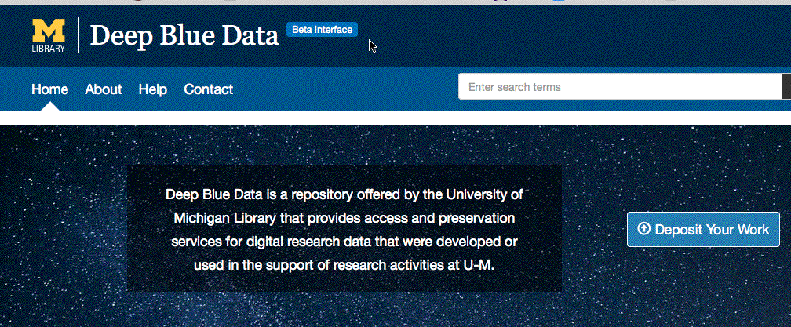
Technology Services

Slide 21
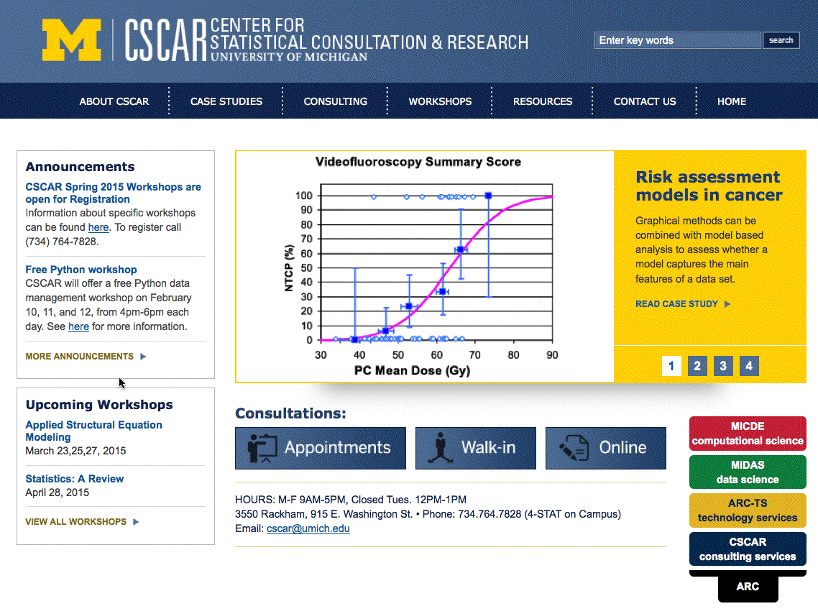
Scientific Consulting Services

Slide 22
Scientific Consulting Services

Slide 23
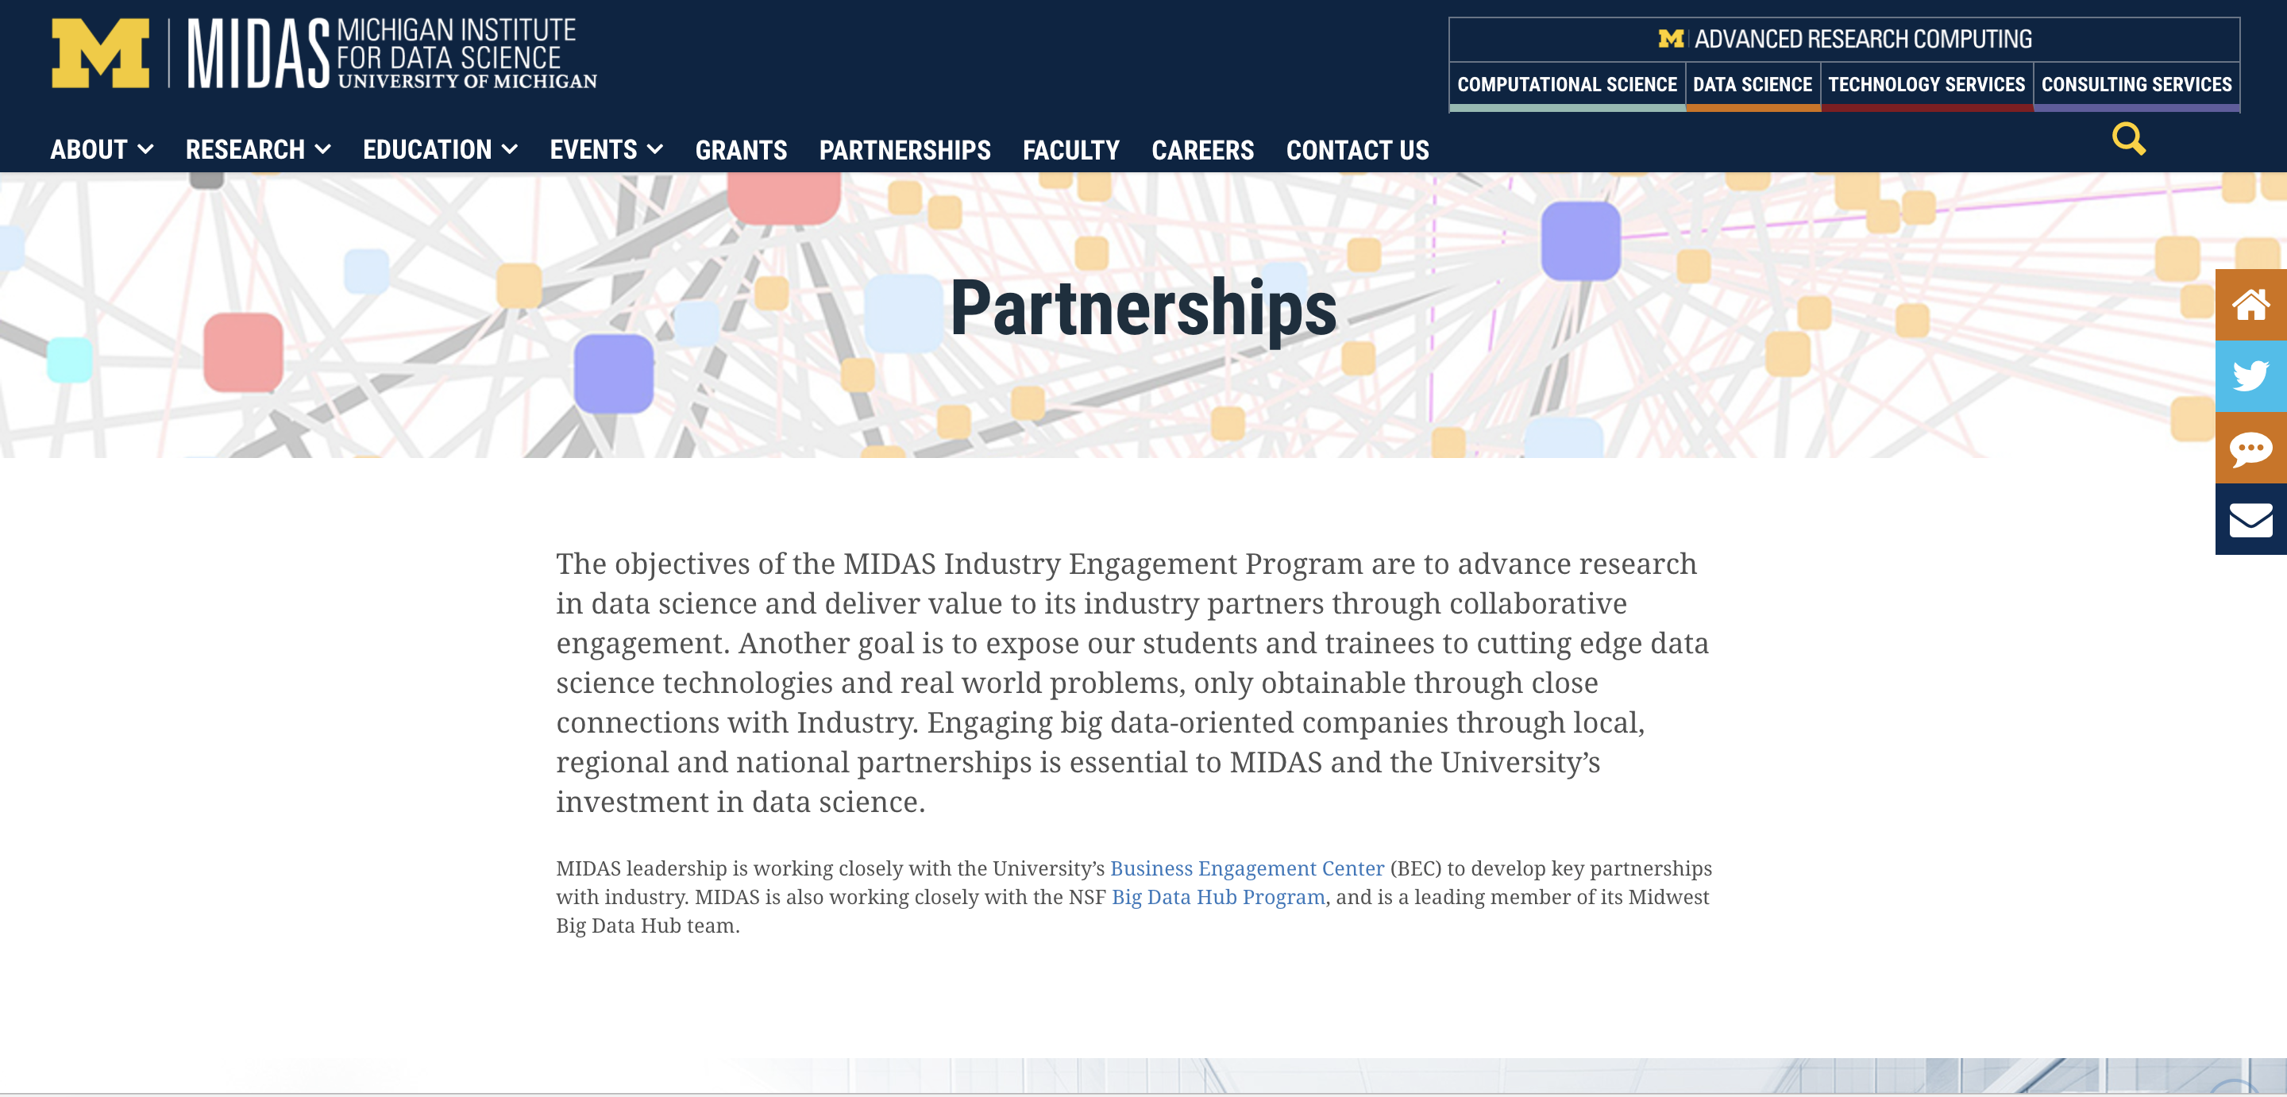
Placement? TBD

Slide 24
How Michigan is Getting on with Data Science
Define the foundational pillars leading to success
Fill in the missing components
Degrees and certificates: the PhD Scientific Computing was too hard. Created a certificate program
Domain-science focused Data Science and Computational focused Data Science are different. We built a domain-focused Data Science institute (MIDAS)
Technology: built secure data caves, DB clusters, clouds of all sorts.
Training: CSCAR grows to provide “expert” training. Data Science becomes an “add-on certificate” to a degree.
Industry connections: conferences where academics are the minority. Networking through a next generation of data scientists. Industry internships.
The daily grind (the really hard part)

Slide 25
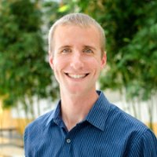
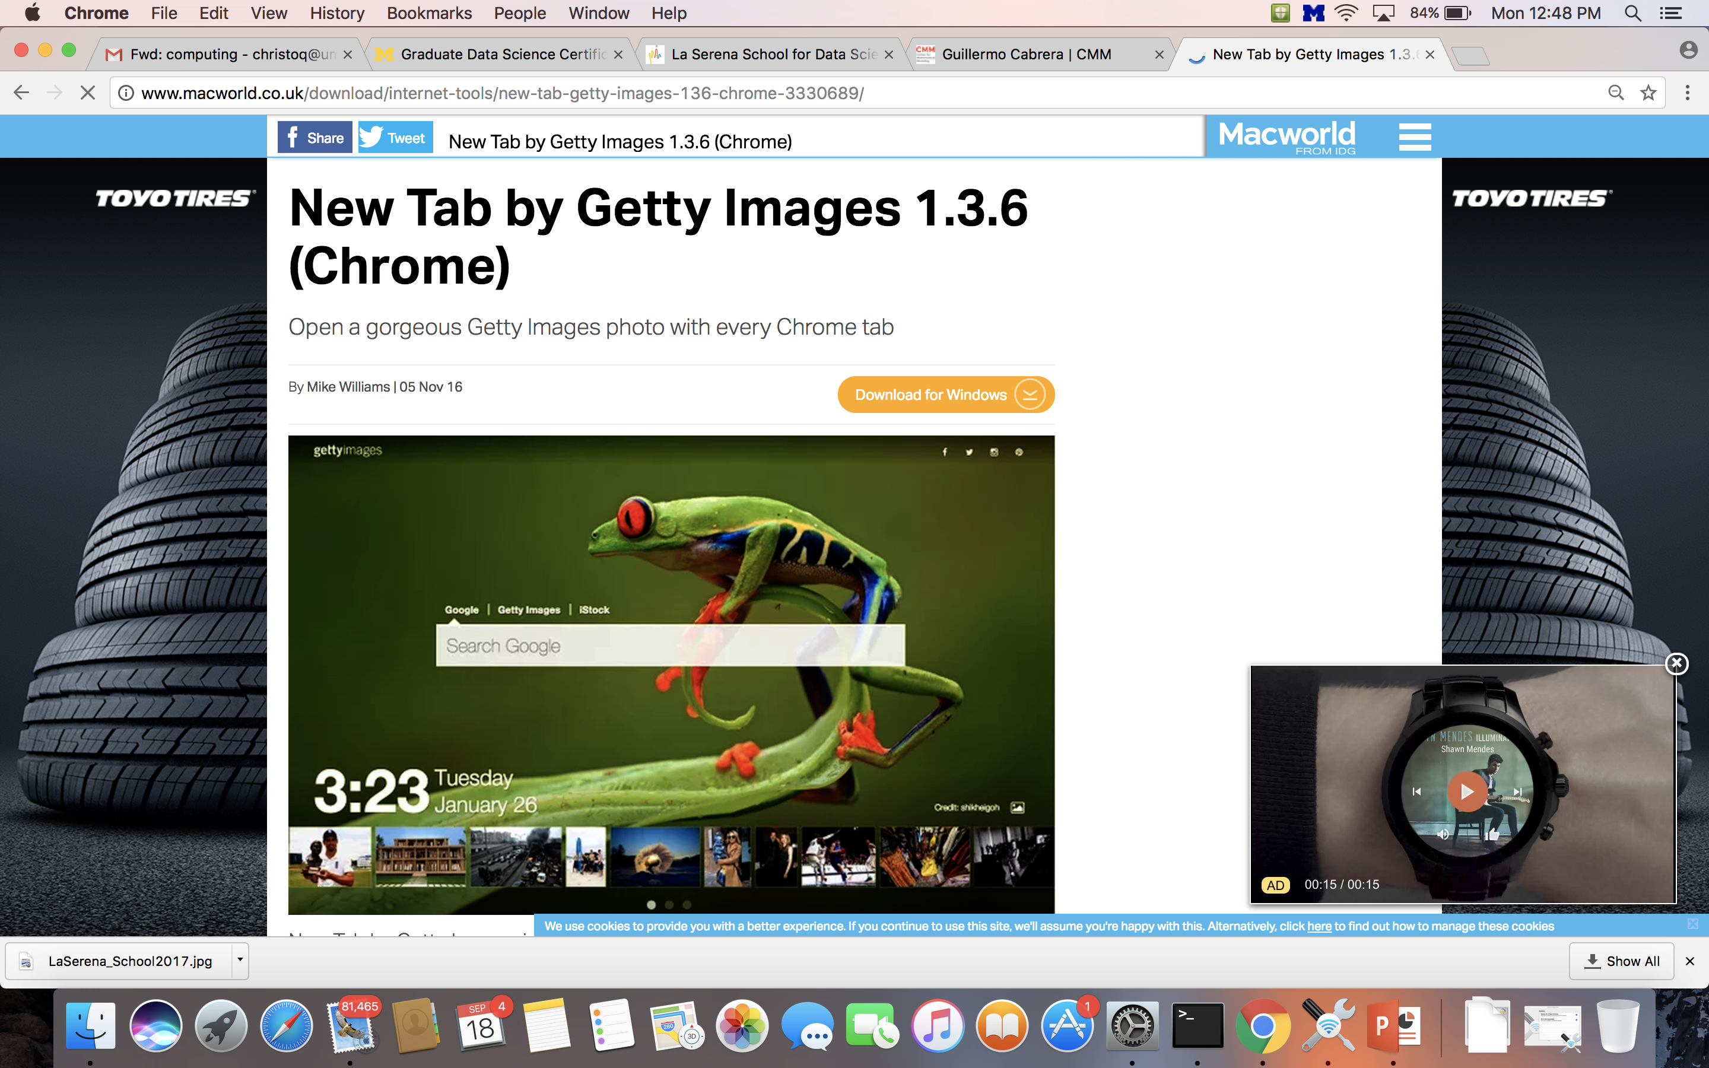
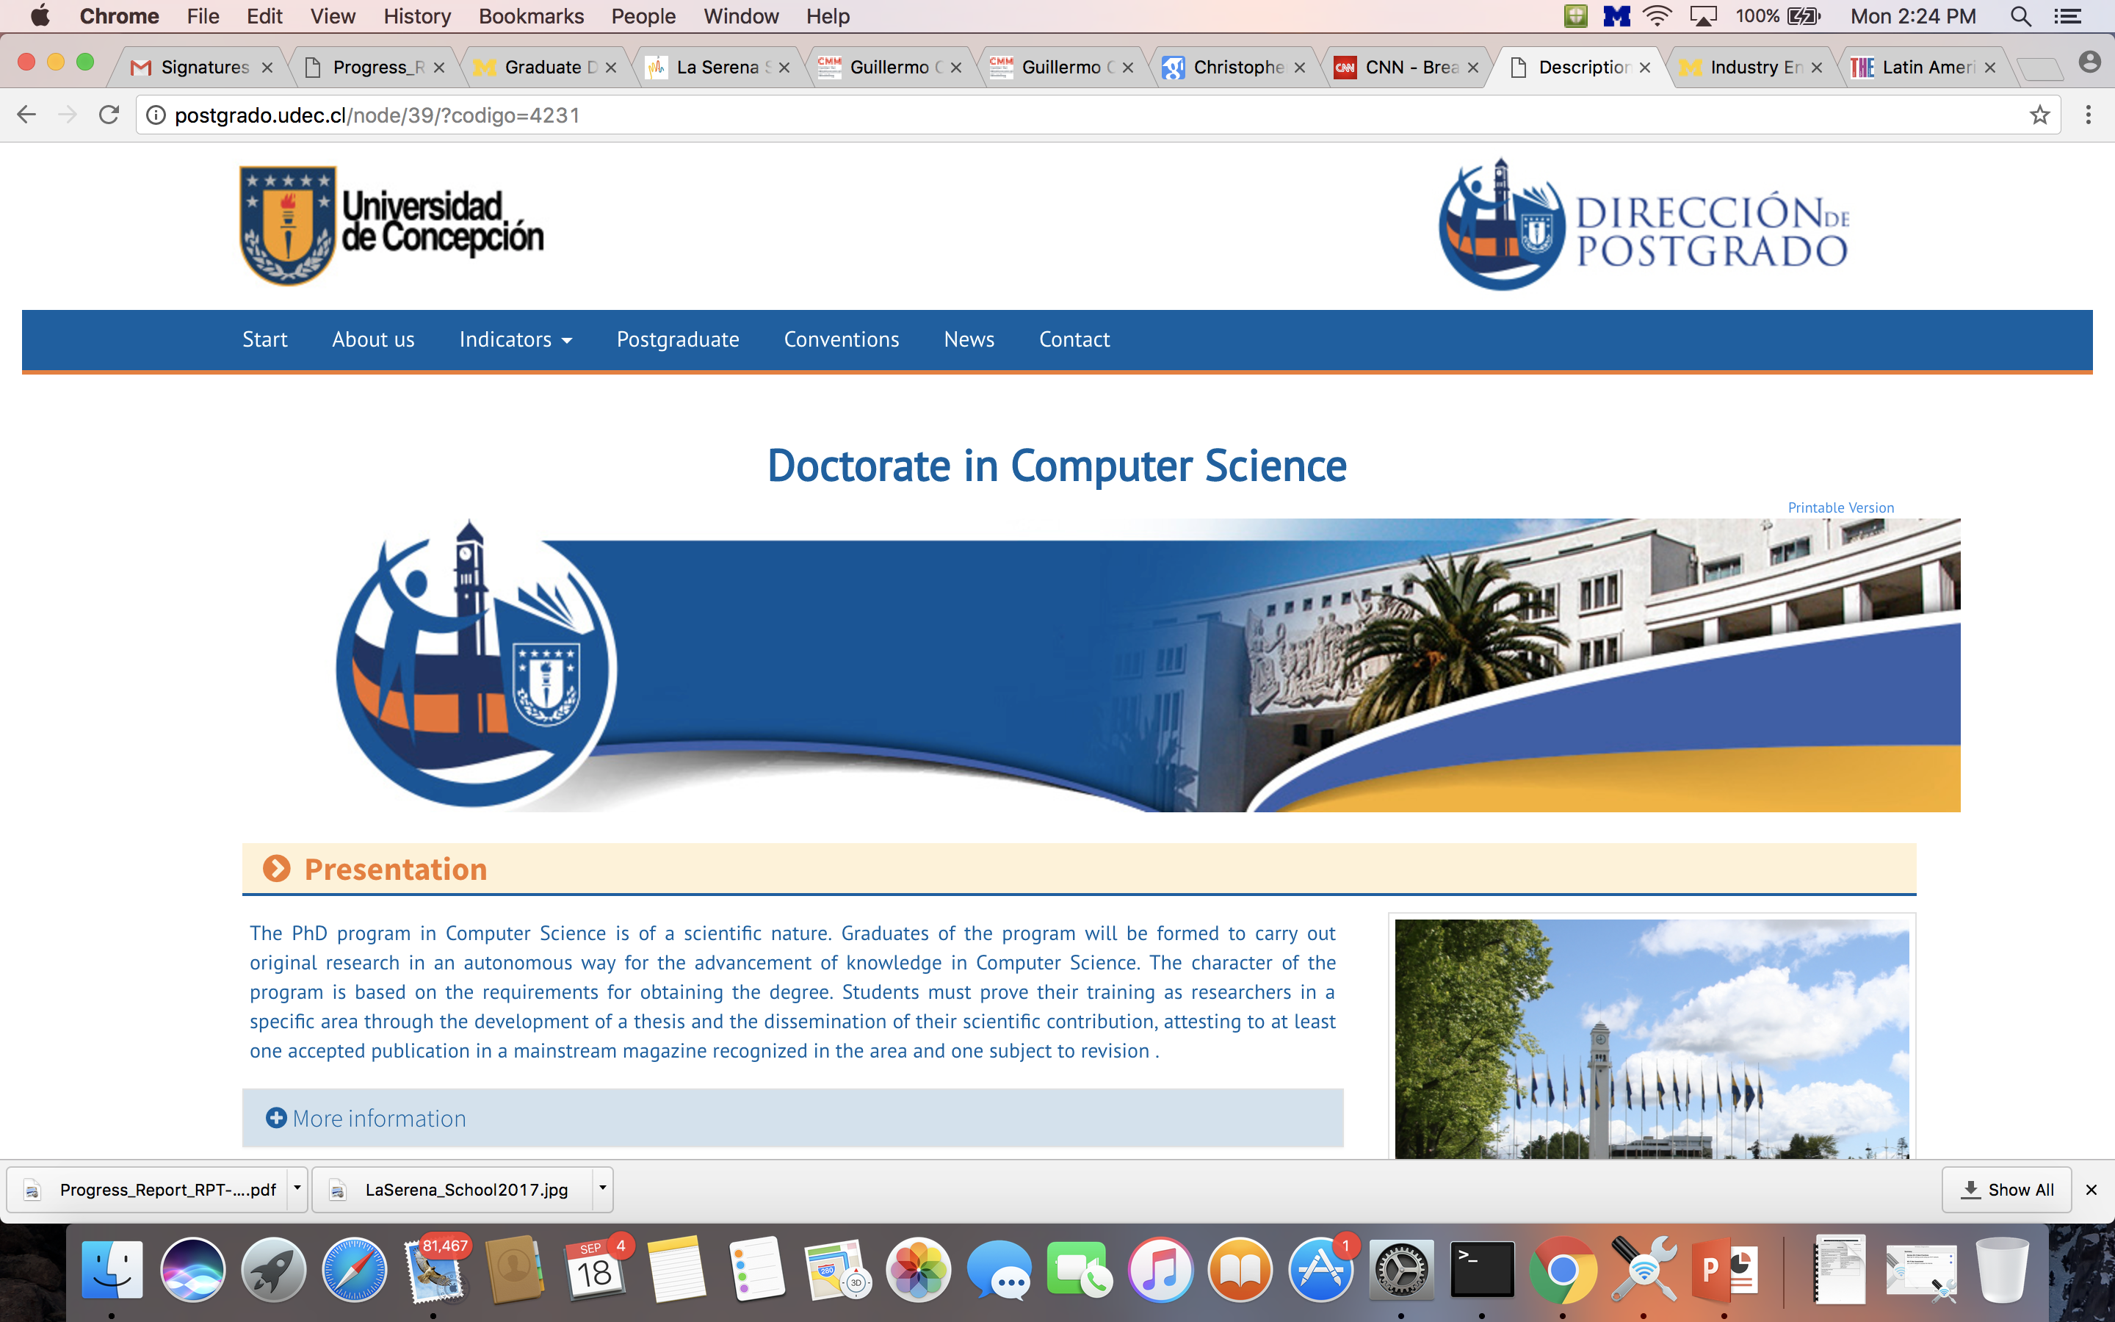
My first PhD Students: non-Astronomers
Guillermo Cabrera 2015
Assistant Professor
Department of
Computer Science
University of Concepcion
Concepcion, Chile
Daniel Gifford 2016
Data Scientist (1st)
Getty Images
Seattle, WA USA

